Slide 1
Travel Explorer
Presented By:
1. Himaja Sadhu-KLH University-CSE

Slide 2
OUTLINE
Problem Statement
System Development Approach
Algorithm & Deployment
Result
Conclusion
Future Scope(Optional)
References

Slide 3
Problem Statement
Fragmented & Slow Planning: Users must constantly switch between different websites for photos, weather, activities, and reviews, making the process inefficient.
Poor User Experience: Juggling multiple tabs and inconsistent interfaces leads to a disjointed and often frustrating planning experience.
Generic Recommendations: Most platforms provide generic, one-size-fits-all suggestions that fail to cater to a user's specific interests and travel style.
Information Overload: The sheer volume of available information can be overwhelming, making it difficult for users to make confident decisions.
Need for a Unified Solution: A single, intelligent platform is required to consolidate essential data and deliver a personalized, streamlined research process.

Slide 4
System Approach
Frontend Technologies:
HTML5: For the core structure of the web application.
Tailwind CSS: For creating a modern, utility-first, and fully responsive design.
JavaScript : For DOM manipulation, handling API calls (async/await), and creating a dynamic user experience.
External APIs:
OpenWeatherMap API: To fetch and display real-time weather data for any destination.
Unsplash API: To source and display a gallery of high-quality, professional photos.
Google Gemini API: To power an AI-driven feature that generates custom, day-by-day travel itineraries based on user preferences.
Design Approach:
Clean, minimalist, and intuitive user interface with a focus on usability.
Single-Page Application (SPA) experience where content updates dynamically without page reloads.

Slide 5
Algorithm & Deployment
User Input: The application captures the user's desired travel destination from a search bar.
Concurrent API Calls: Upon form submission, asynchronous fetch requests are made simultaneously to the OpenWeatherMap and Unsplash APIs.
Dynamic UI Update: The fetched weather data and image gallery are rendered dynamically on the page, replacing the initial welcome message.
AI Itinerary Generation: The user can optionally input the number of trip days and their interests (e.g., Food, History). This triggers a new API call to the Google Gemini API.
AI Response Handling: The AI-generated itinerary is returned as formatted HTML and displayed in a user-friendly accordion view.
Deployment: The project is deployed as a static website using a free hosting service like GitHub Pages or Netlify for easy access and sharing.

Slide 6
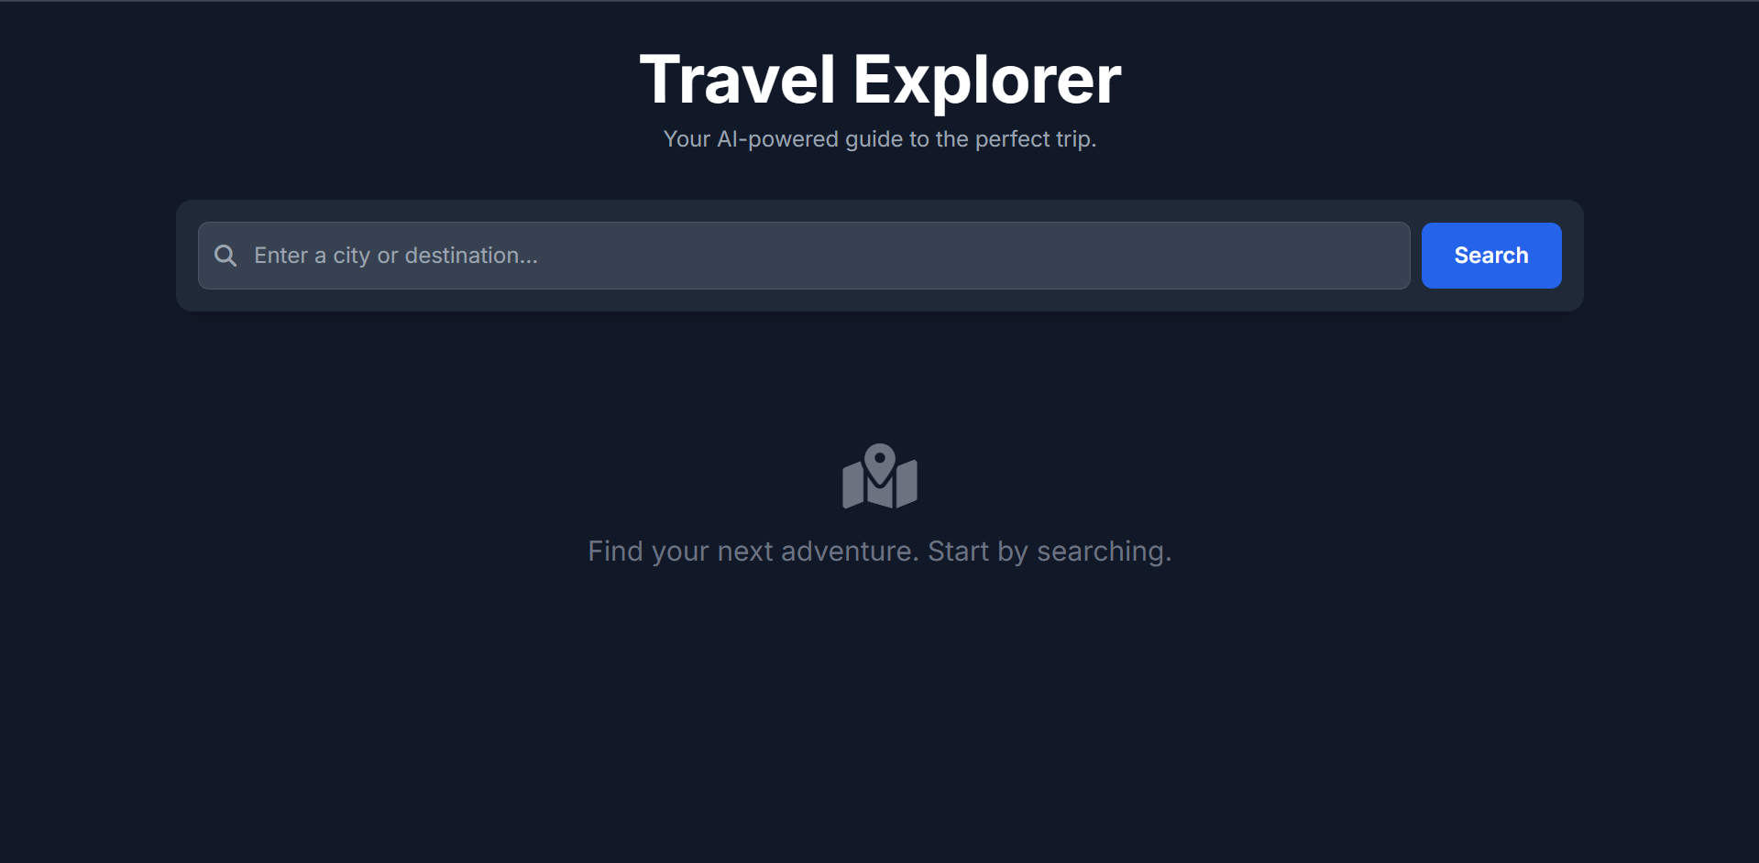
Result

Slide 7
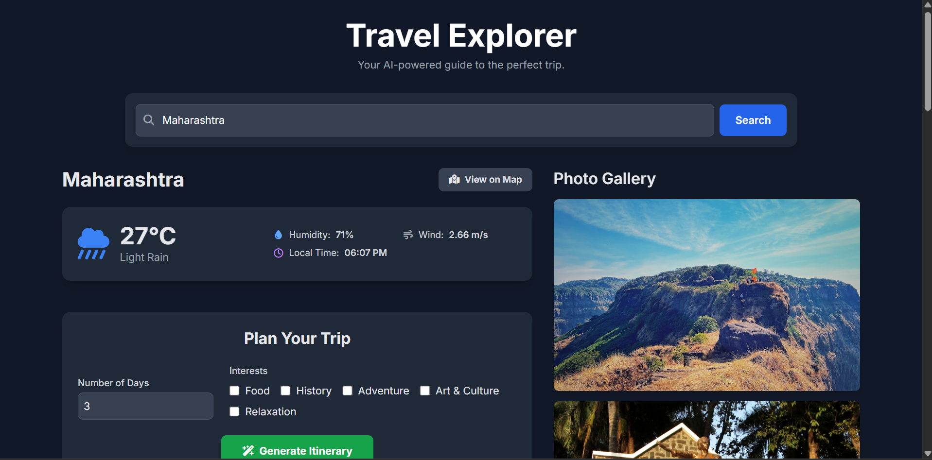

Slide 8
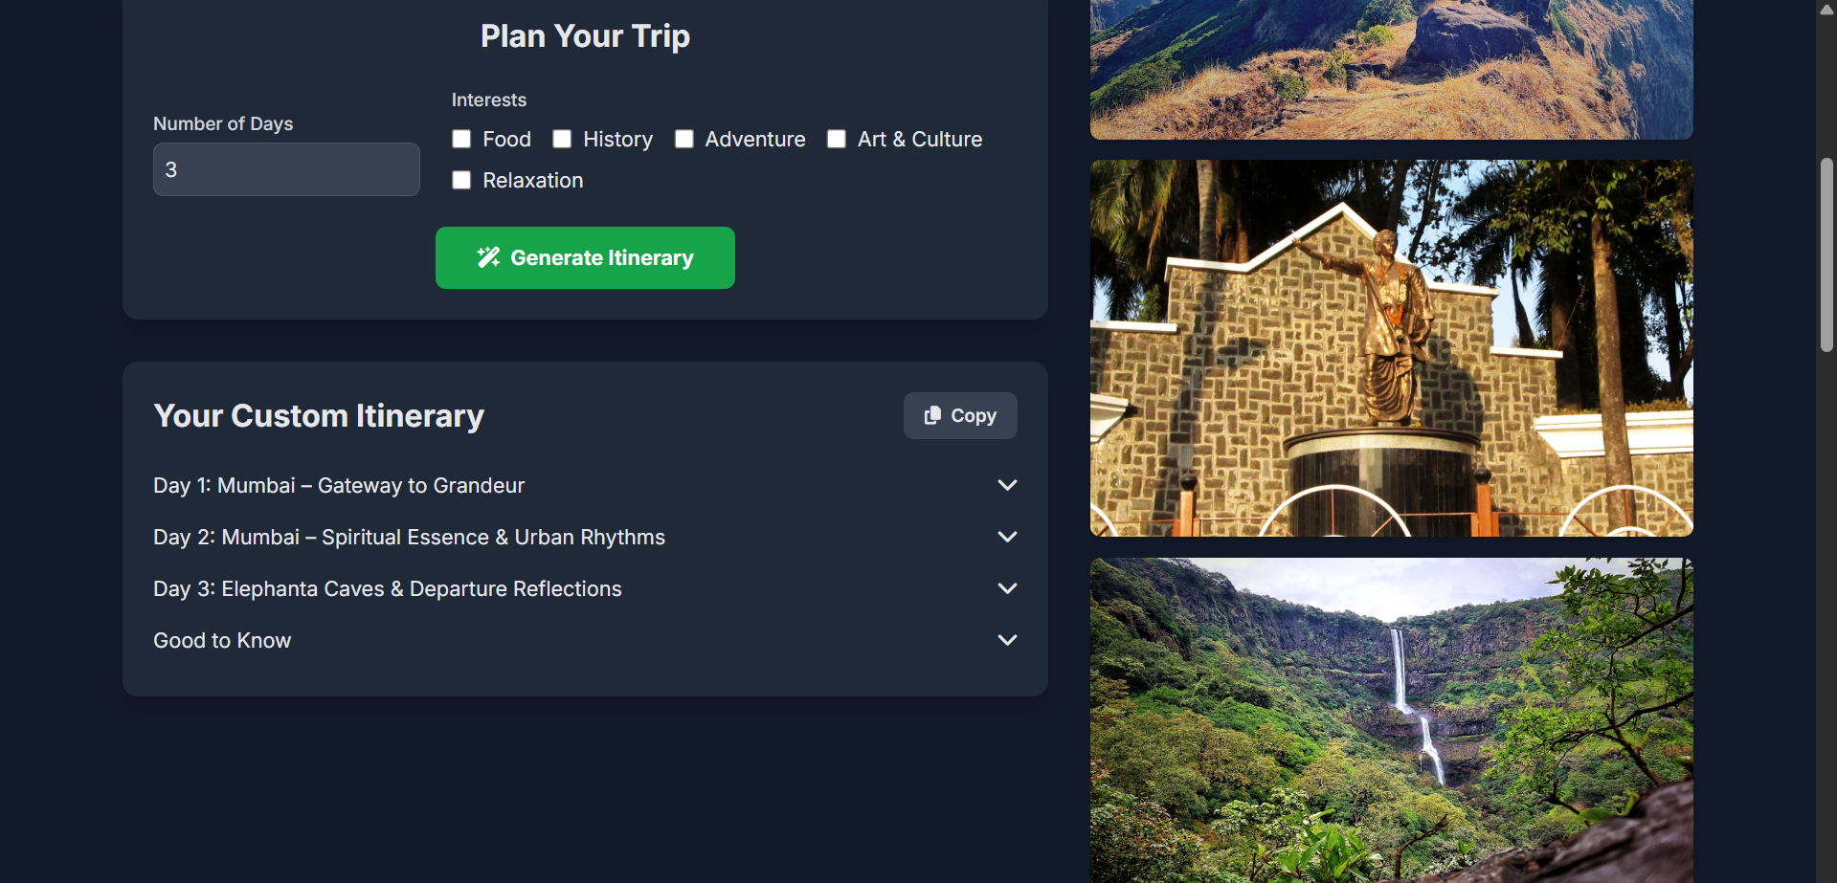

Slide 9
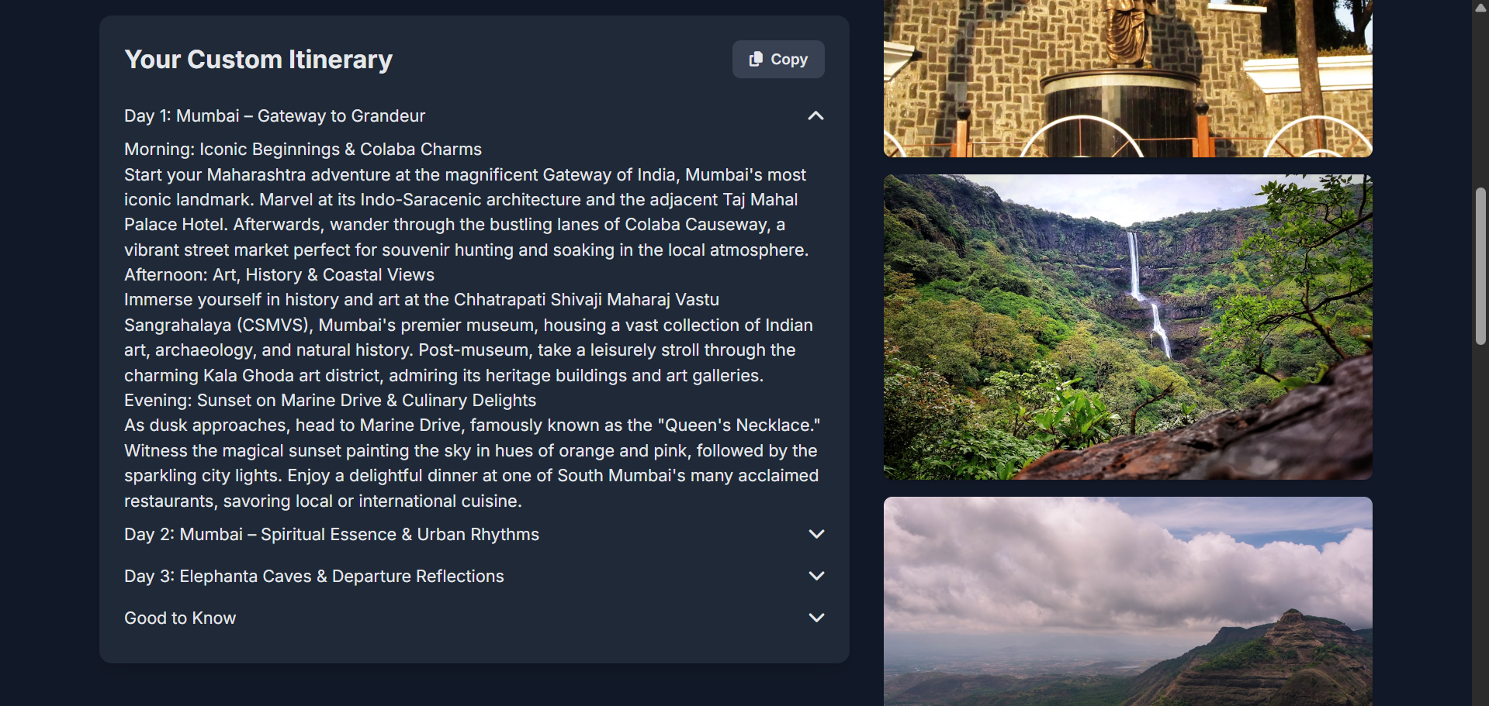

Slide 10
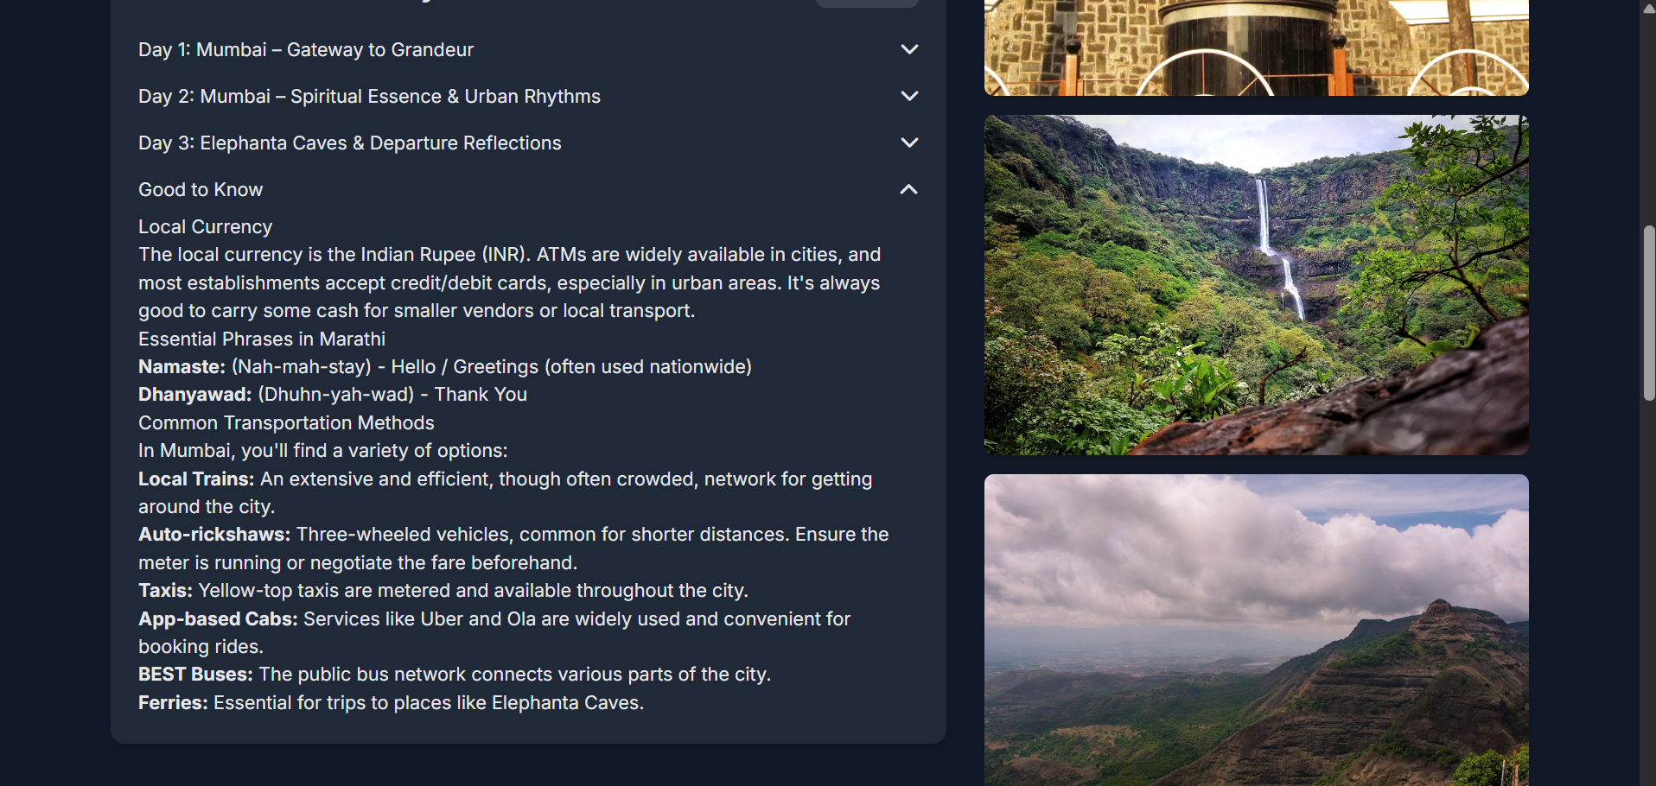

Slide 11
Github Link
https://github.com/himaja-56/Travel_Explorer.git
DEPLOYMENT Link
https://travel-explorer-3wp6.onrender.com/

Slide 12
Conclusion
Successfully developed a unified, single-page application that streamlines the trip-planning process, reducing the need for users to visit multiple websites.
Demonstrated the effective integration of three distinct third-party APIs (for data, images, and AI) to build a cohesive and feature-rich tool.
Successfully leveraged a modern Large Language Model (LLM) via the Gemini API to provide significant user value through personalized, dynamic content generation.

Slide 13
Future scope
User Accounts & Saved Trips: Implement a backend (e.g., using Firebase) to allow users to create accounts and save their generated itineraries.
Booking Integration: Connect with flight and hotel booking APIs to allow users to take the next step in their planning process directly from the app.
Interactive Map View: Use a library like Leaflet.js or the Google Maps API to plot the generated itinerary locations on an interactive map.
Expanded Data Sources: Integrate additional APIs for finding local restaurants, events, or real-time currency exchange rates.

Slide 14
References
OpenWeatherMap API Documentation: https://openweathermap.org/api
Unsplash API Documentation: https://unsplash.com/developers
Google AI for Developers (Gemini API): https://ai.google.dev/
Tailwind CSS Documentation: https://tailwindcss.com/docs

Slide 15
THANK YOU

